Slide 1
TECHNOLOGY UNIVERSITY (HMAWBI)
Linux Server Configuration
DEPARTMENT OF INFORMATION TECHNOLOGY
(Web Server,Database Server,Mail Server,FTP server)
SUPERVISED BY: DAW SOE MOE THEINGI
LECTURER
PRESENTED BY: Mg SOE LA PYAE HTUN
VI-IT-30

Slide 2
Outline
Abstract
Aim and Objectives
Background Theory
System Flow

Slide 3
Abstract
-Server-based computing represents an important part of the way people access data services
-The servers are essential to be configured in order to access the websites and to connect the network all over the world.
-Nowadays, universities, companies and other organization establishes the severs to have own website and email with personal domain name.
-Most servers used for web hosting running at least three kinds of software servers which are web server, mail server, FTP server and database server.

Slide 4
Aim And Objectives
-To access website or web-app via internet browser everywhere and everytime
-To apply own mail server and web server for university,office,company,organization
- To share data as well as to share resources and distribute work.
- To allow users in the network to run and use application,
without having to install a copy on their own computer

Slide 5
Background Theory
Server
- A system that responds to requests across a computer network to provide, or help to provide, a network or data service.
Web Server
- A system that processes requests via HTTP, the basic network protocol used to distribute information on the World Wide Web.
Database Server
- A database server, performs tasks such as data analysis, storage, data manipulation, archiving, and other non-user specific tasks.
FTP Server
-An FTP server is a software application running the File Transfer Protocol (FTP), which is the protocol for exchanging files over the internet from client to server.

Slide 6
Mail Server
- The terms mail server, mail exchanger, and MX host may also refer to a computer performing the MTA(message transfer agent) function.
-The Domain Name System(DNS) associates a mail server to a domain with an MX record containing the domain name of the host(s) providing MTA(message transfer agent) services.
Linux
-Linux is a free open source operating system (OS) based on UNIX.
-Users can modify and create variations of the source code, known as distributions, for computers and other devices.
-The most common use is as a server, but Linux is also used in desktop computers, smartphones, e-book readers and gaming consoles, etc.

Slide 7
Command -line Interface(CLI)
-A command-line interface or command language interpreter (CLI), is a means of interacting with a computer program where the user (or client) issues commands to the program in the form of successive lines of text (command lines).
-A program which handles the interface is called a command language interpreter or shell.
BASH
-Bash is a command processor that typically runs in a text window, where the user types commands that cause actions.
-Bash can also read and execute commands from a file, called a script.
-It supports filename wildcard , piping , here documents, command substitution, variables, and control structures for condition-testing and iteration.

Slide 8
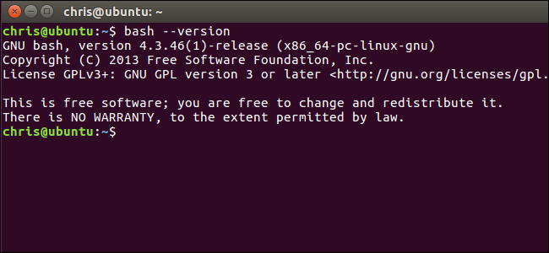
Example >>>
Terminal Emulator
-A terminal emulator is a program that emulates a video terminal within some other display architecture.
-A terminal window allows the user access to a text terminal and all its applications such as command-line interfaces (CLI) .
-These may be running either on the same machine or on a different one via telnet, ssh, or dial-up.

Slide 9
System Flow
Host
Apache Server,Apache Tomcat,Lighttpd,node.js and etc
Web
Server
DNS setup and configuration
Web Server Security conf..
PHP,Python,java and etc
Various CMS and Web app installation
CrushFTP,Pure-FTPD,VsFTPd,ProFTPd and etc
FTP
Server
Installation webmail app and configure
Subdomain setup and configuration
mariaDB Server,
Mysql Server and etc
Database
Server
SendMail,PostFix,Qmail
And etc
Mail Server
Subdomain setup and configuration
POP configure , IMAP configuration

Slide 10
Host
MAC permission
Web Server Security
Various CMS and Web app installation
Web
server
Web Server Security
MAC permission
PHP,Python,java and etc
Apache Server,Apache Tomcat,Lighttpd,node.js and etc..
Various CMS and Web app installation
Data-
base server
Mail
Server
PRESENTED By: Mg SOE LA PYAE HTUN
VI-IT-30

